Slide 1
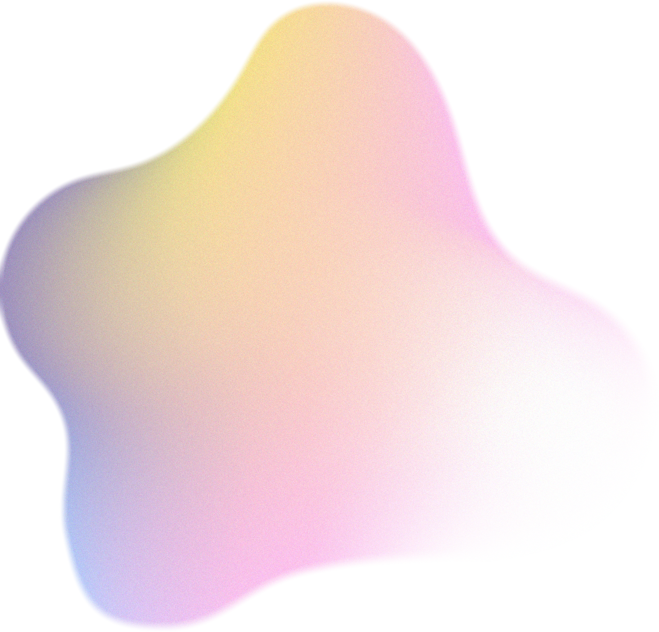
Knee OA Classification Using Bone Distance
CS-671 : Final Project
Clive Lewis Tarun Ramapuram
Min Jung

Slide 2

Introduction
Framework & Tools
Initial Code Implementation
Enhancement
Midterm Results
Model Comparison
Results from Pytorch Models
Analysis & Conclusion
Agenda

Slide 3


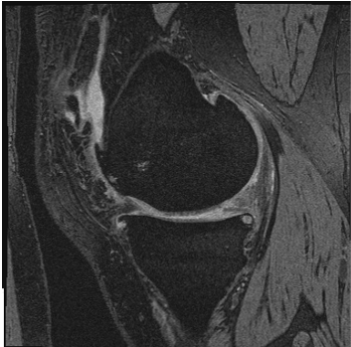

Introduction
Osteoarthritis (OA) is the most common form of arthritis in the knee.
Cartilage is the slippery tissue on the ends of bones, in between joints, and elsewhere in the body.
The thickness of cartilage is an important biomarker to access the severity of knee OA.
In this project, we will process a sequence of bone mask images, which are segmented from knee MRI images using an automatic segmentation method called Unet.

Slide 4

Problem Statement
Develop an algorithm to measure the distance between femur and tibia bones in the bone masks.
We shall use the distances as features to predict the severity level of knee OA.

Slide 5
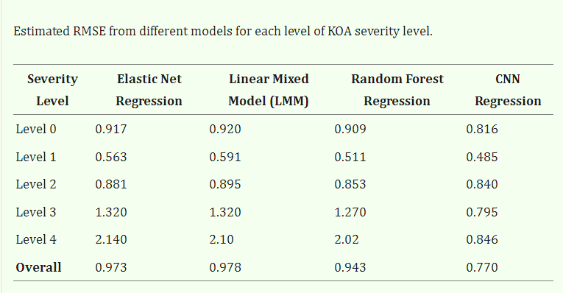
Literary Review
Predicting knee osteoarthritis severity: comparative modeling based on patient’s data and plain X-ray images ^{[1]}
Data set:
Patient vital signs
Symptoms of KOA
Medication history
Functional impairment
Xray images
Models Used:
Elastic Net regression
Random forest
Linear mixed effect model
Convolution neural network

Slide 6

Framework & Tools
Image Processing | Machine Learning Models
MATLAB: Processable.m AverageCartilageThickness.m Splitter.m main.m | WEKA: SVM Multilayer Perceptron Random Forest Pytorch: Logistic Regression Random Forest Gradient Boosting SVM LightGBM XGBoost

Slide 7

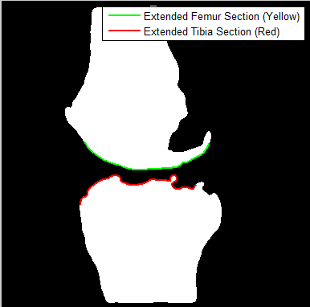
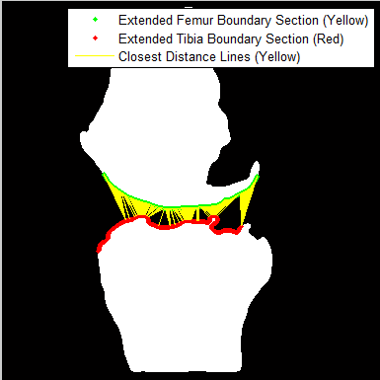
Initial Code Implementation
Core Algorithm:

Slide 8
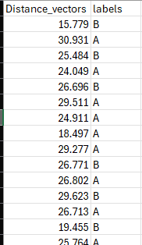
Initial Code Implementation
Pipeline for image processing:
Data Output from algorithm:
All images processed one by one based on case name.
Image is checked whether it is processable or not based on percentage of non-zero intensity’s.
Vector of distances for each image is averaged out and stored in a local_thickness array till remaining averages are extracted out of all images for the current case.
The zero values are eliminated from local thickness.
All non zero values are averaged and stored as one average value for the case in another separate array.
Process repeated till all cases processed.
Output of all averages are output to a csv file.

Slide 9
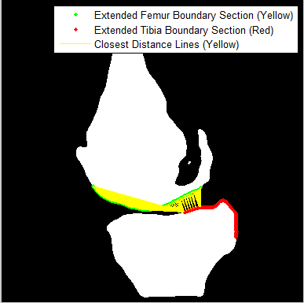
Enhancement
Challenge faced:

Slide 10
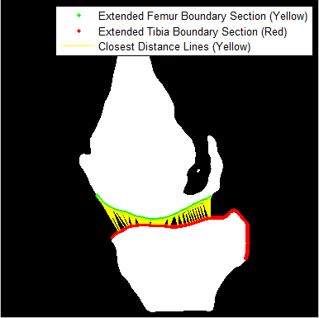
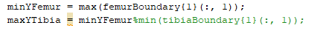
Enhancement
Solution:
Same Y axis value for femur is used for Tibia:
Non-zero percentage increased to 20%:

Slide 11
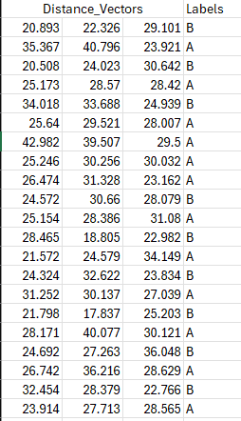
Enhancement
Average Value computed across 3 separate regions
Random Forest Model Executed using Pytorch on Google Colab

Slide 12
Midterm Results

Slide 13
Model Comparison
Objective:
Compare machine learning models with transformed features between Advanced Neural Networks & ML Classifiers. Evaluate performance using neural networks.

Slide 14
Pipeline
Models Compared
1
Data Preprocessing
Fill missing values, Label Encoding, Standard Scaling.
Logistic Regression
2
Feature Transformation
Gradient Boosting
Use ML models to transform features.
LightGBM
3
Neural Network
Residual NN + Attention Mechanism to classify data.
Random Forest
SVM
4
Cross-Validation
10-Fold Stratified CV ensures robust accuracy.
XGBoost

Slide 15
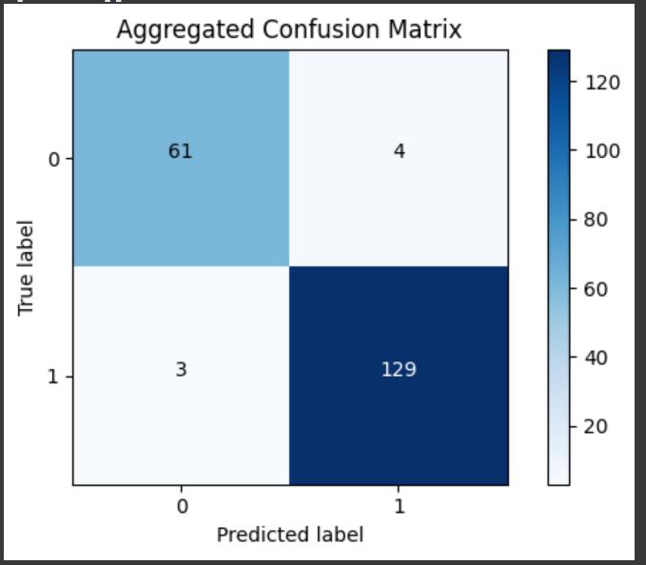
Results from the Pytorch Model
Algorithm | Accuracy | F1-Score | ROC
LightGBM | 0.96 | 0.96 | 0.95
XGBoost | 0.89 | 0.87 | 0.86
Random Forest Tree | 0.80 | 0.78 | 0.75
Support Vector Machine | 0.79 | 0.75 | 0.73
Logistic Regression | 0.79 | 0.75 | 0.75
Gradient Boosting | 0.77 | 0.73 | 0.69

Slide 16


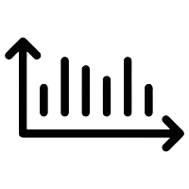
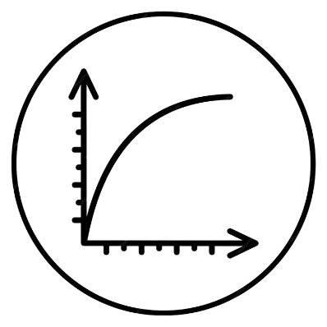
Analysis and Conclusion
LightGBM + Neural Network provides the best accuracy
Mean F1 score across all folds is 0.96
Mean ROC score across all folds is 0.92

Slide 17

Thank you!
Feel free to ask any questions

